Slide 1

Exploring Climate Changes Over Time
DS612 Interactive Data Visualization
Prof. Bhaskar Chaudhury
Shaili Parikh
202418049
Sreelakshmi Nair
202418037
Krishna Tank
202418056
Jatin Sindhi
202418055

Slide 2




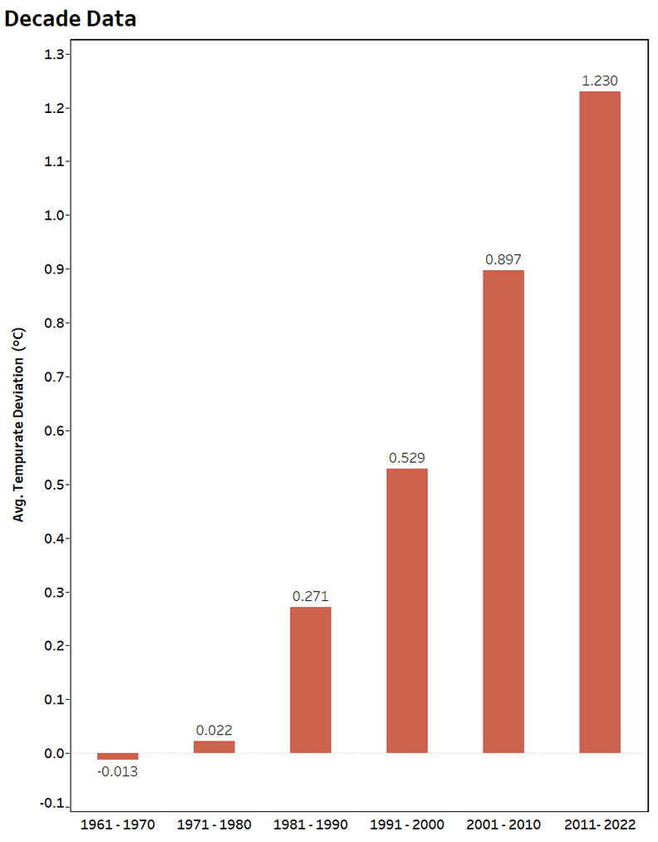

Decadal Rise in Global Temperature Deviation
🧊
Avg. Temperature Deviation (1960 - 2000)
0.2096 °C
🔥
Avg. Temperature Deviation (2000 - 2022)
1.062 °C
Post-2000 Surge in Warming
A steep rise in temperature deviation is evident after 2000, reflecting accelerated global warming.

Slide 3
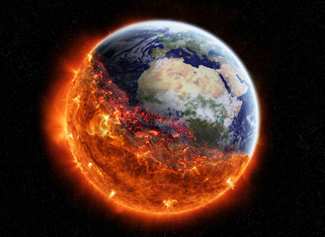
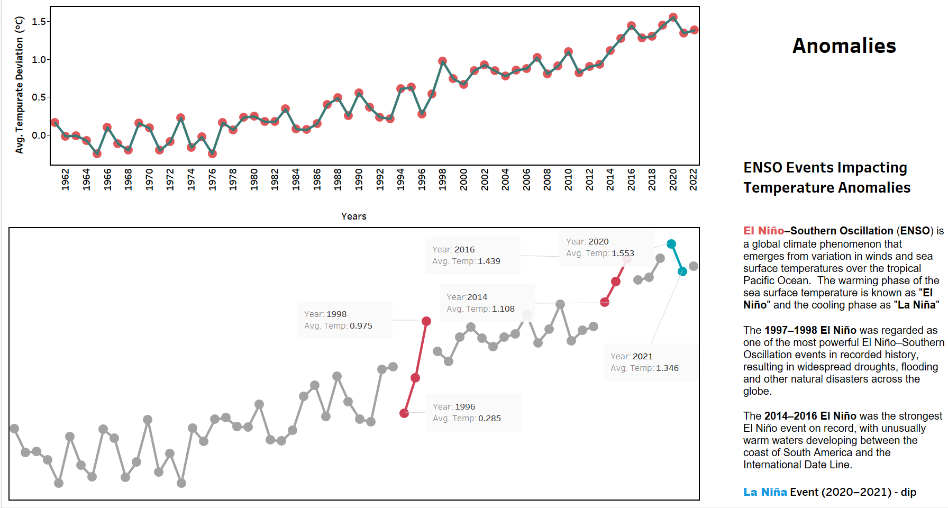
Global Trend of Temperature

Slide 4

Anomalies

Slide 5
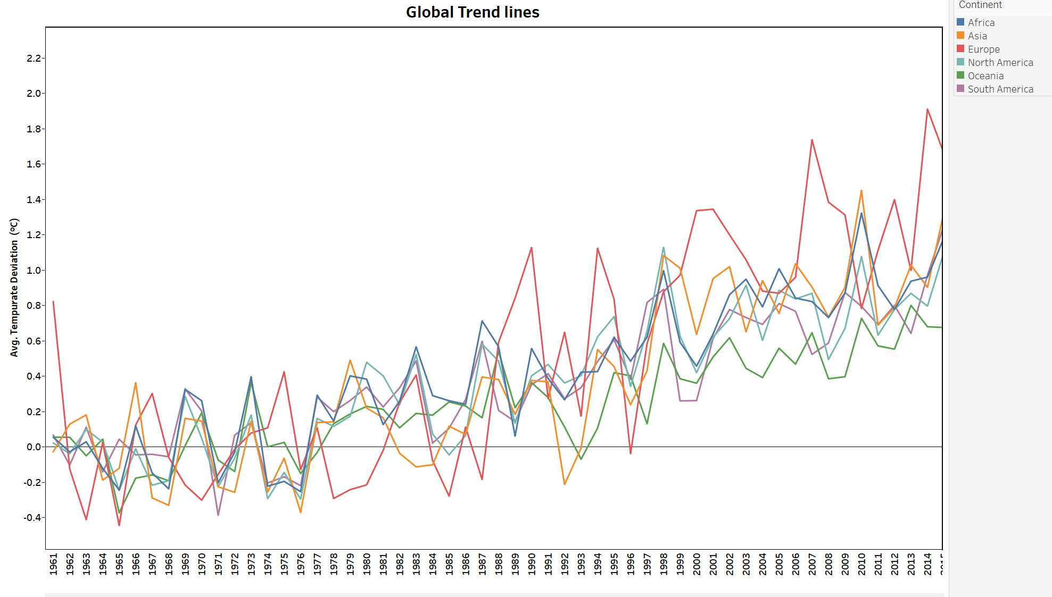

Rising Temperatures Globally (1962–2022)
Avg. Temperature Deviation (Europe)
0.78 °C
🏝️
Avg. Temperature Deviation (Oceania)
0.32 °C

Slide 6
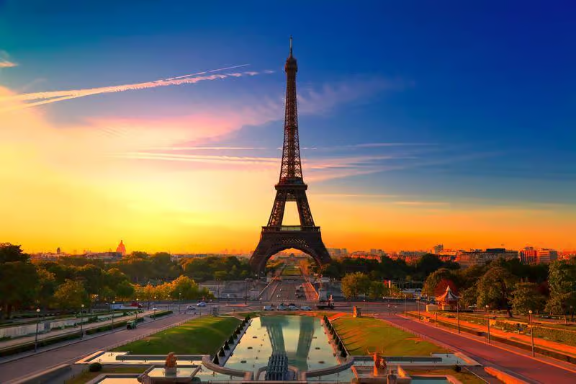
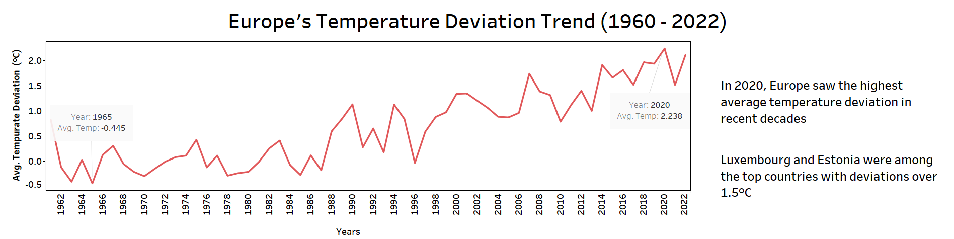

Rising Temperatures in Europe (1962–2022)
Europe has witnessed a dramatic rise in temperature deviation since 1990 — the steepest globally

Slide 7
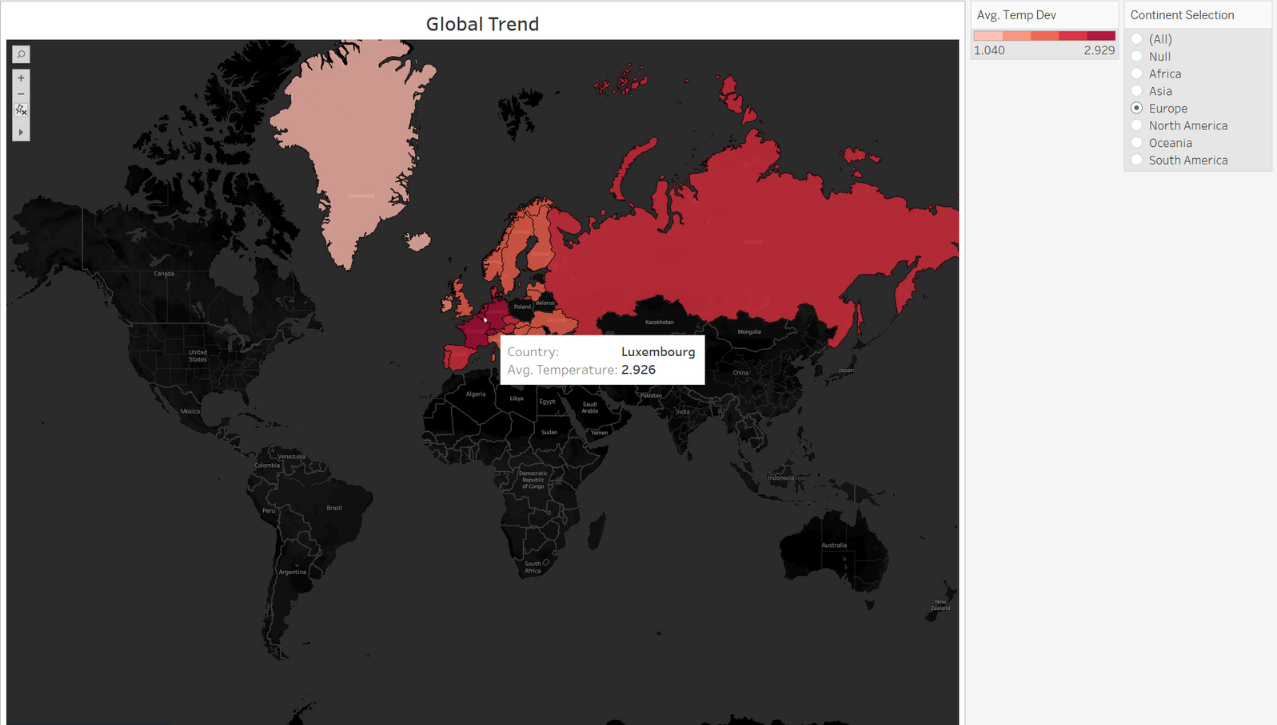
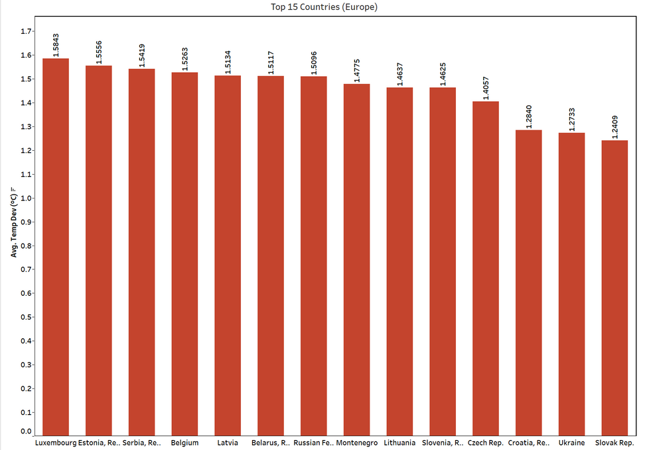
Rising Temperatures in Europe (1962–2022)

Slide 8

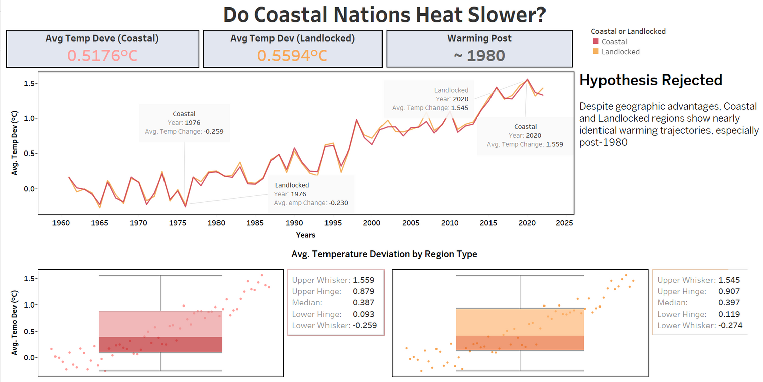

Do Coastal Regions Heat Slower?

Slide 9

Do Coastal Regions Heat Slower?

Slide 10

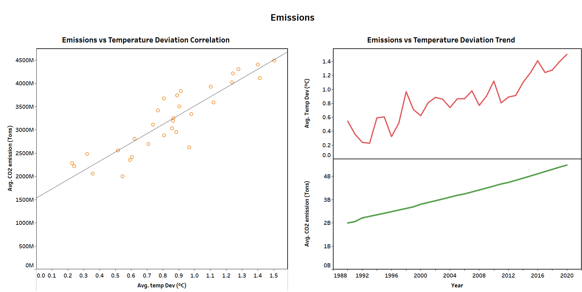

Emissions
🏭

Slide 11


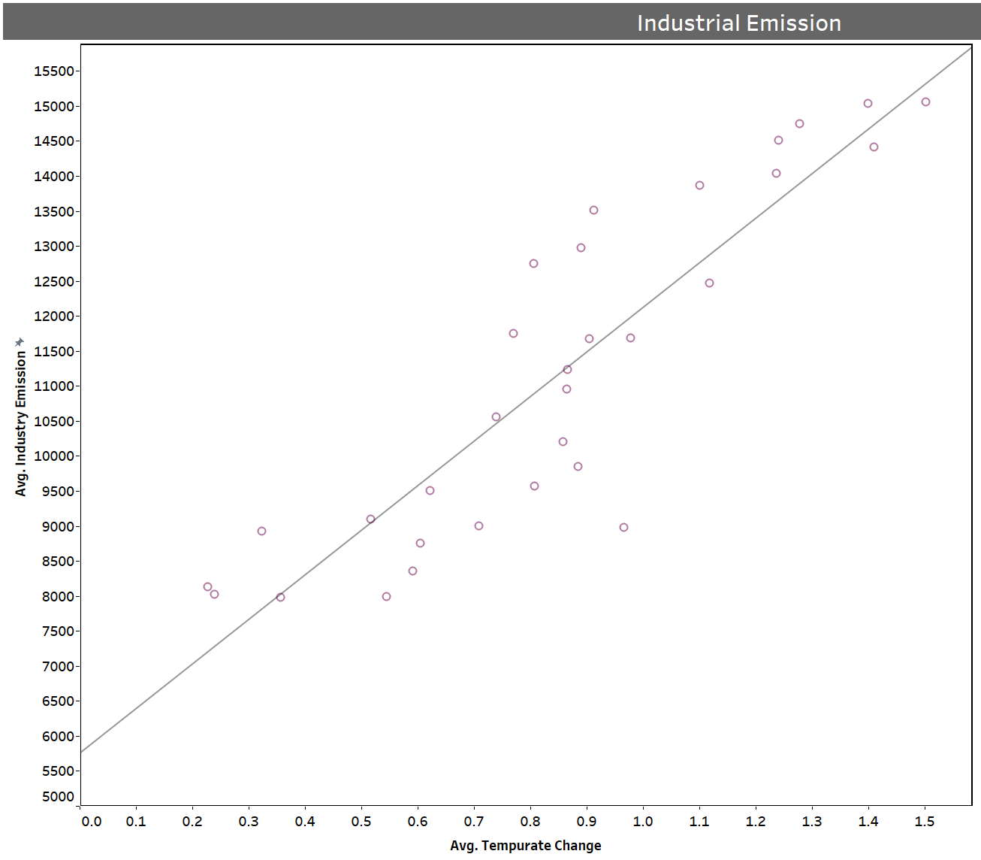
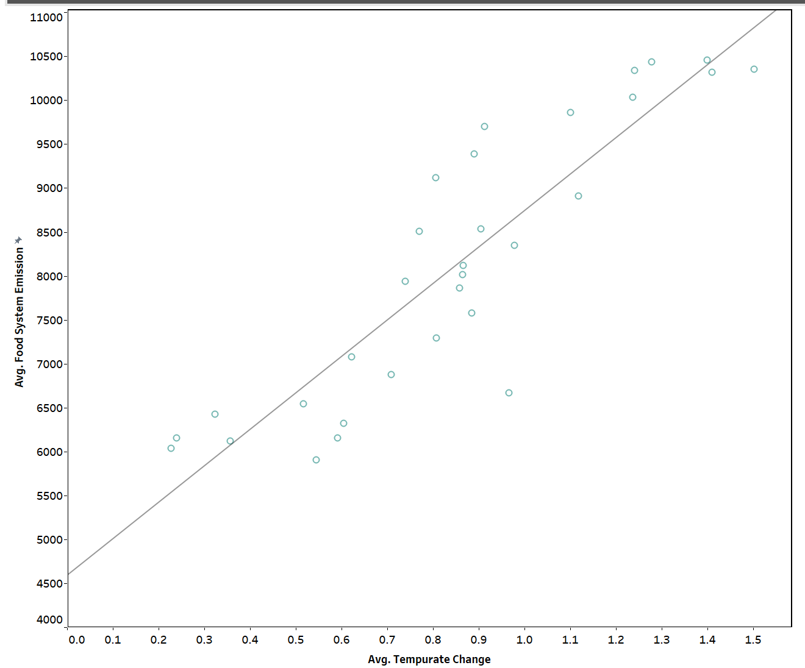
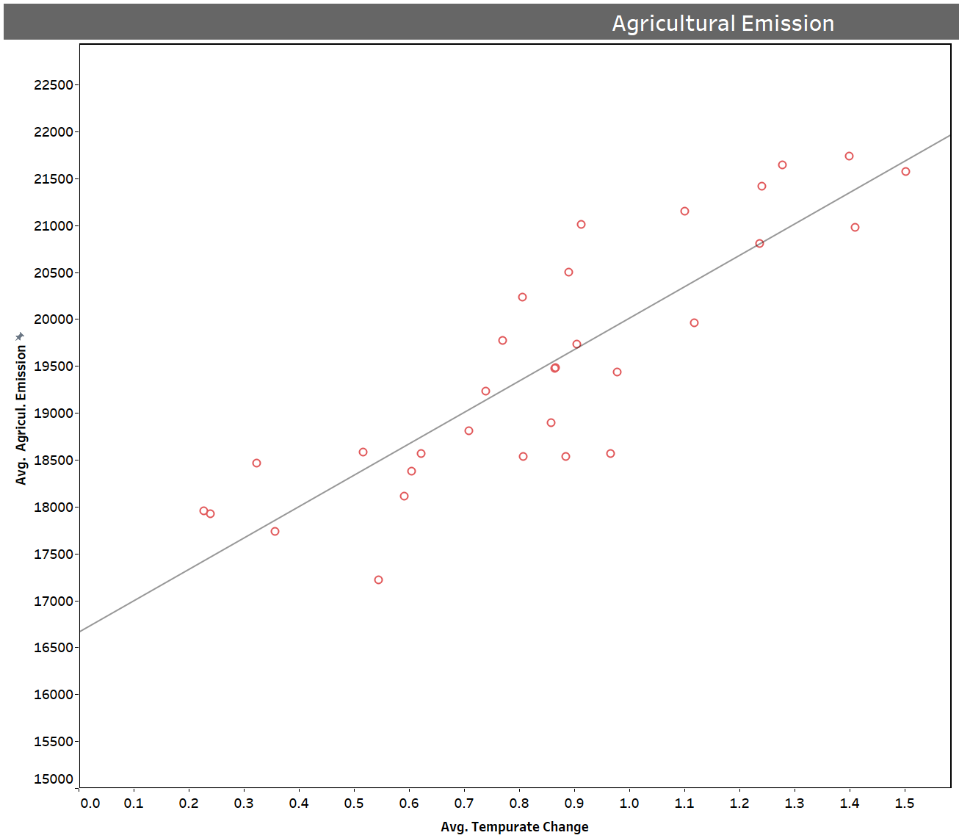
How Different Emissions Affect Temperature Deviation
Industrial Emission
Food Emission
Agricultural Emission

Slide 12
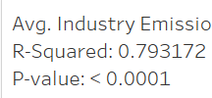
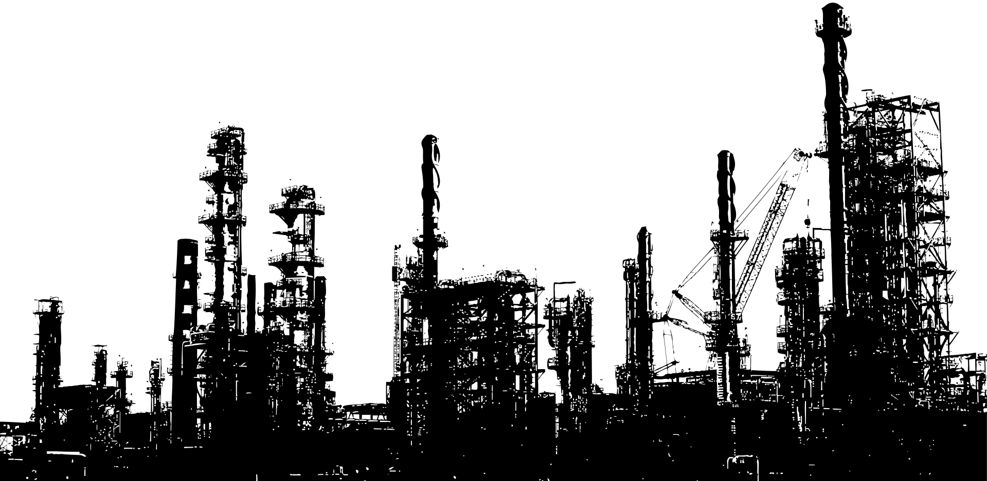
Industrial Emission

Slide 13
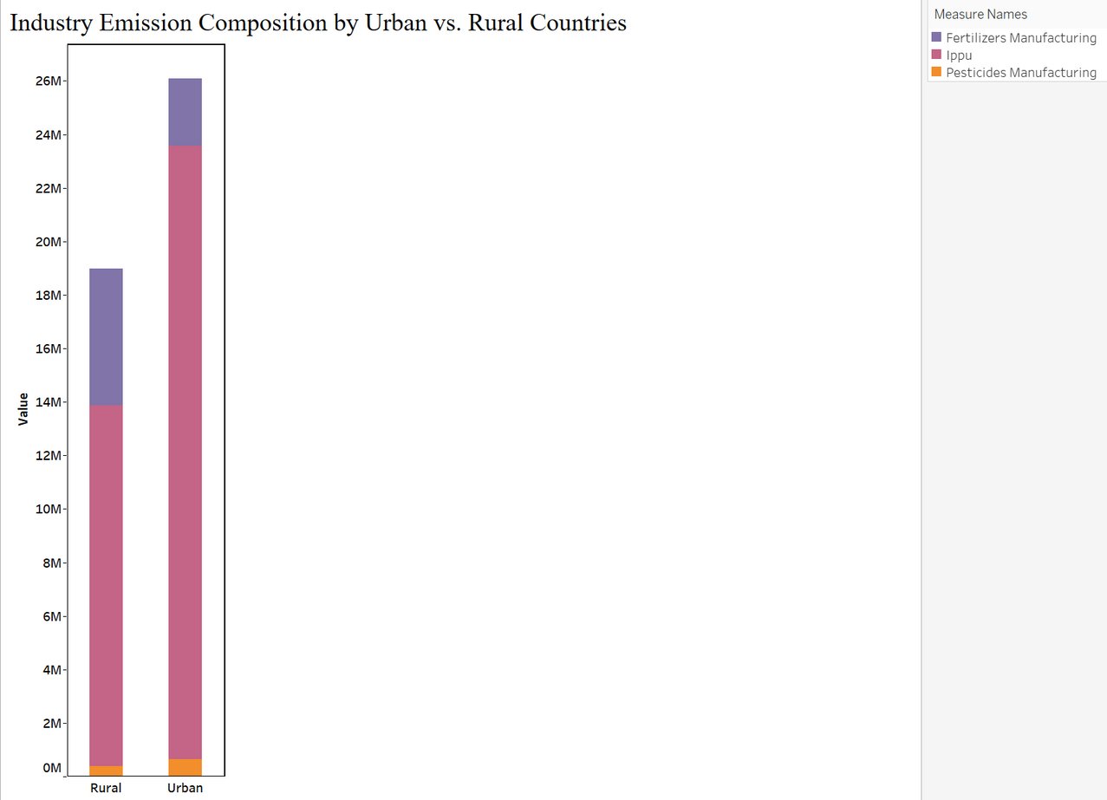
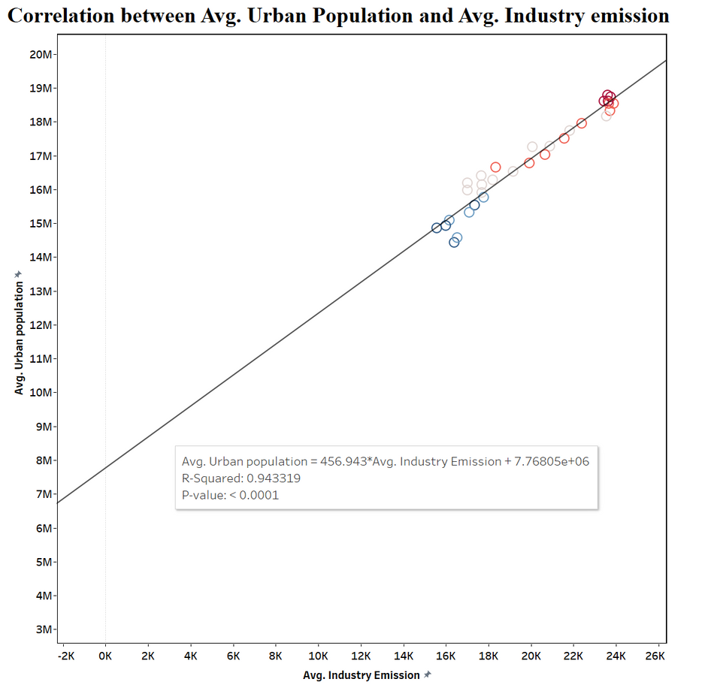
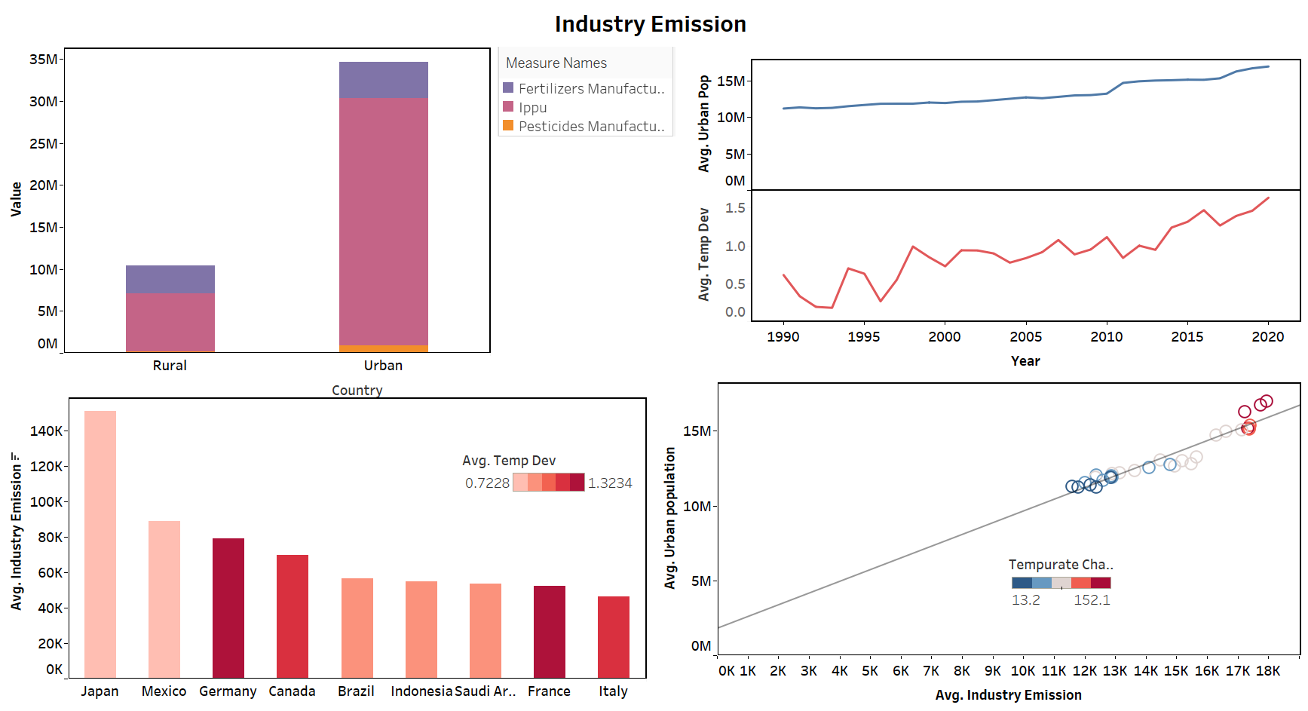
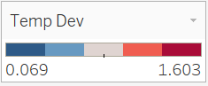
Urban Areas and Industrial Emission

Slide 14
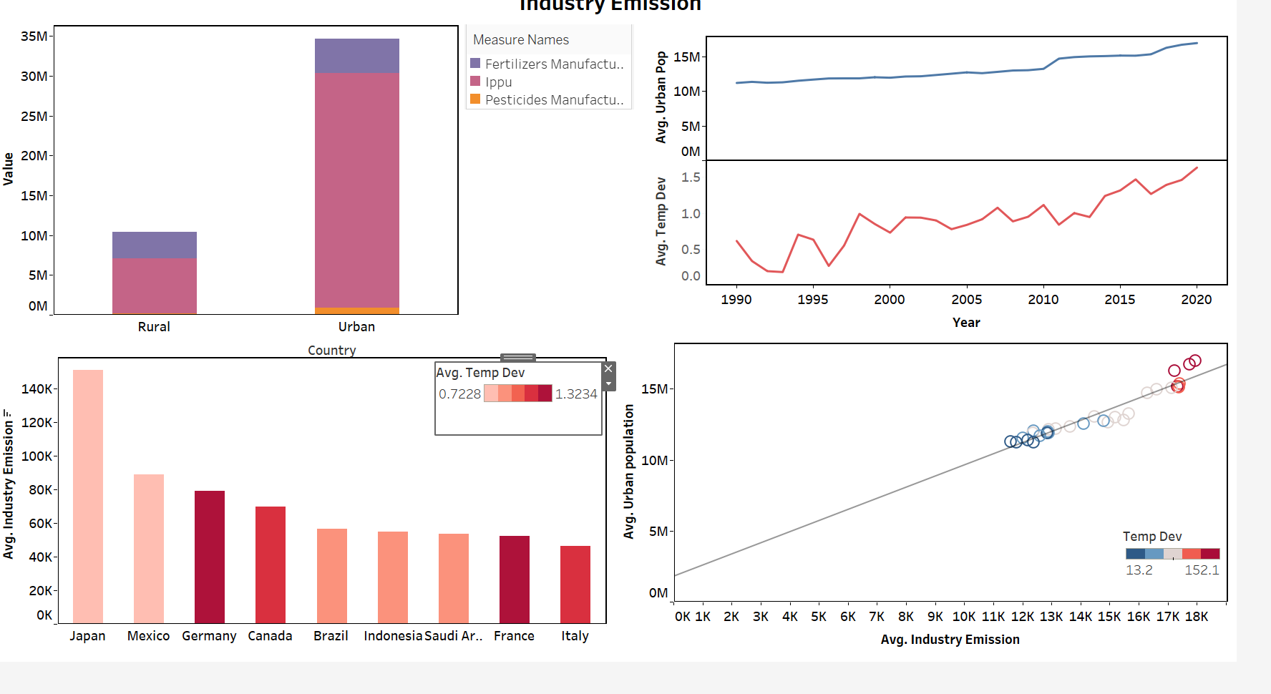
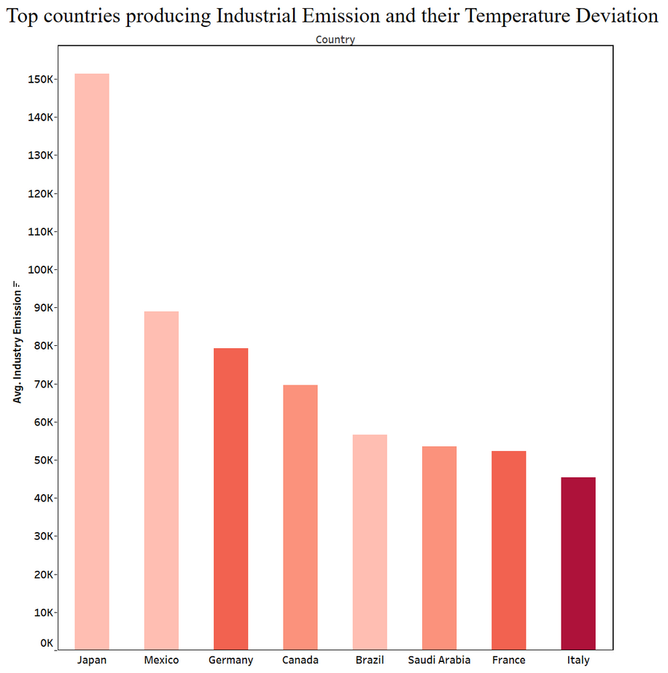
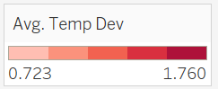
Urban Areas and Industrial Emission

Slide 15
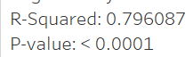

Food Emission

Slide 16
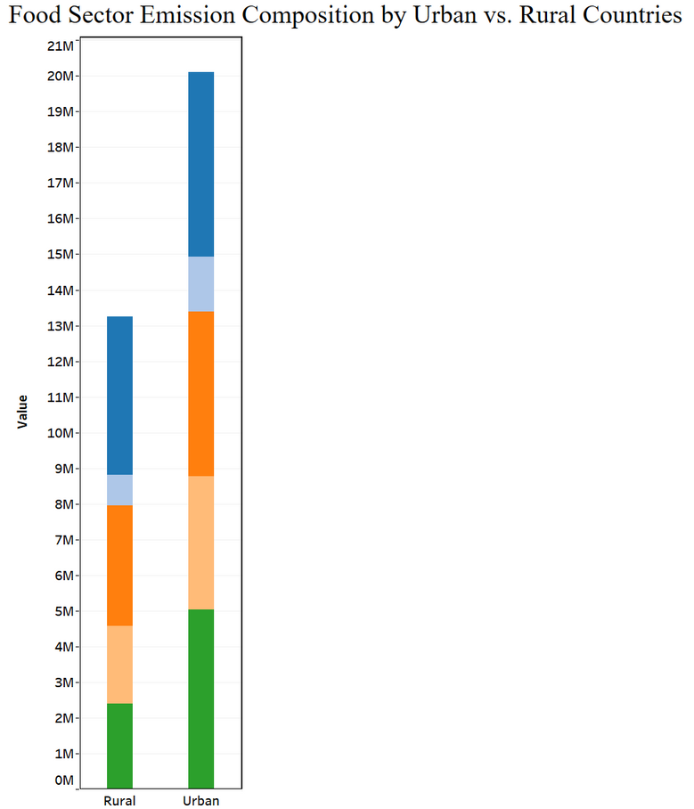
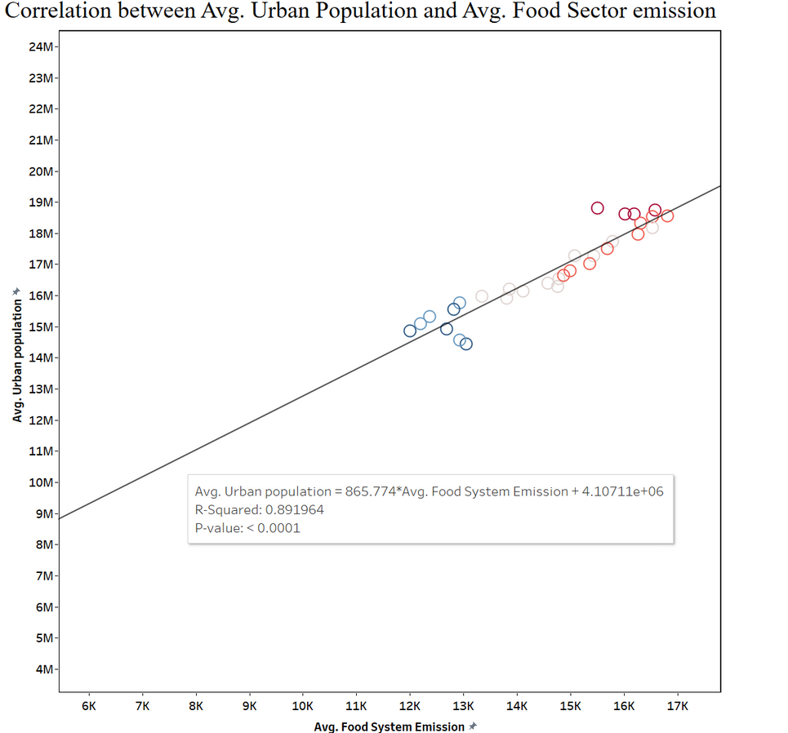

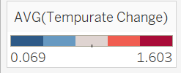
Urban Areas and Food Sector Emission

Slide 17
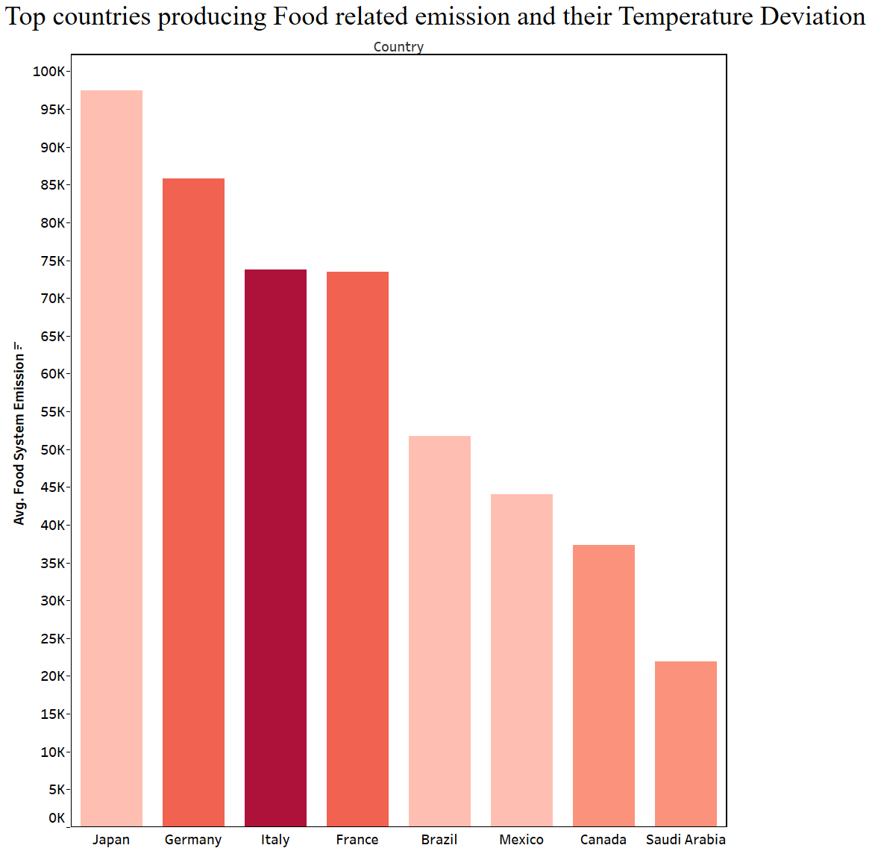
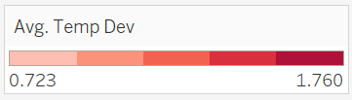
Urban Areas and Food Sector Emission

Slide 18
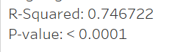

Agricultural Emission

Slide 19
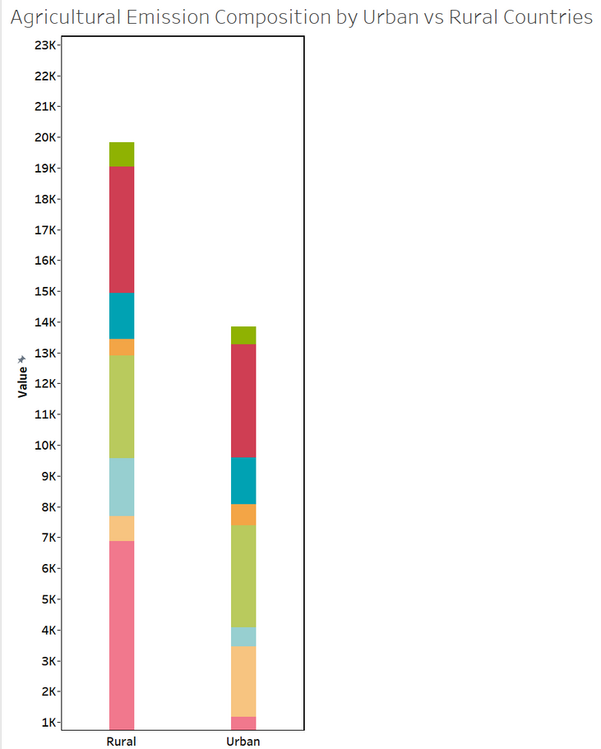
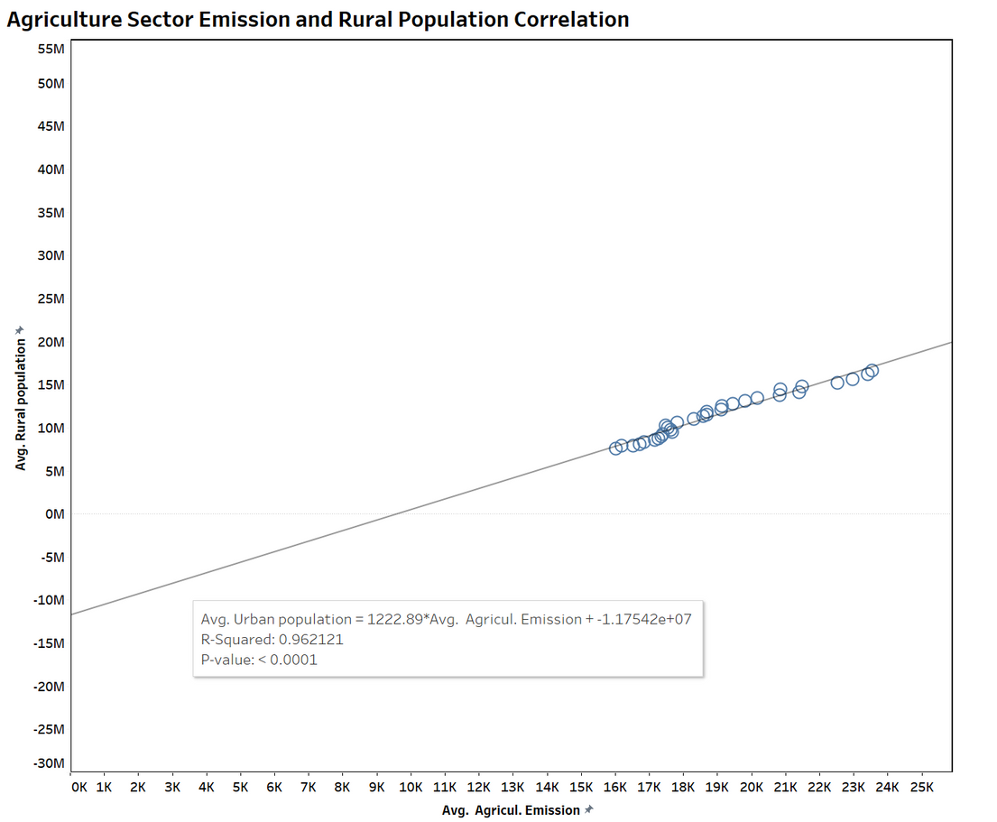
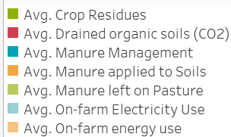
Rural Areas and Agricultural Emission

Slide 20
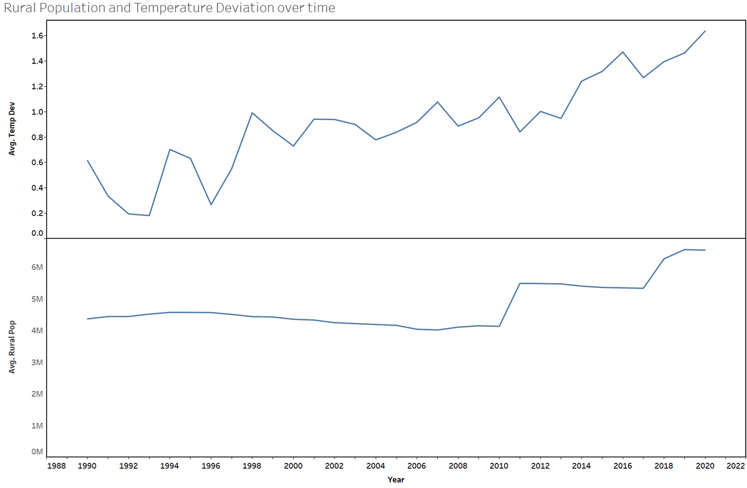
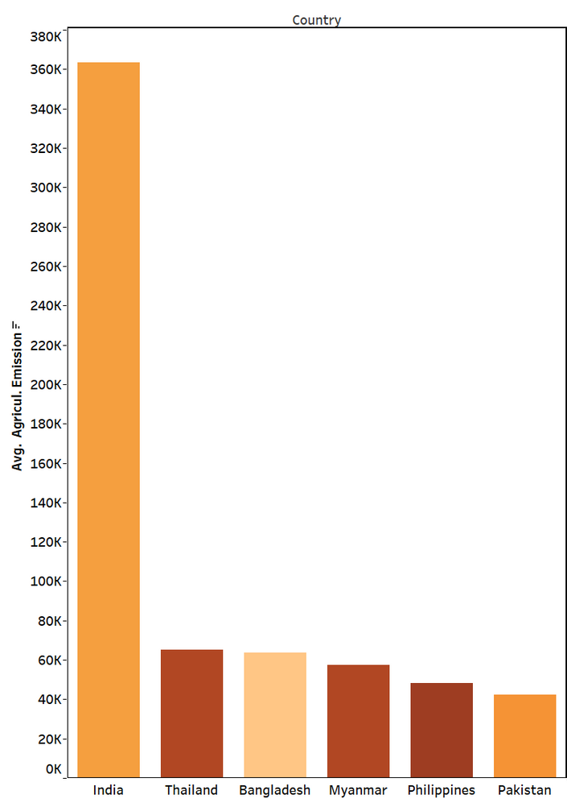
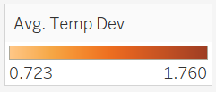
Rural Areas and Agricultural Emission

Slide 21
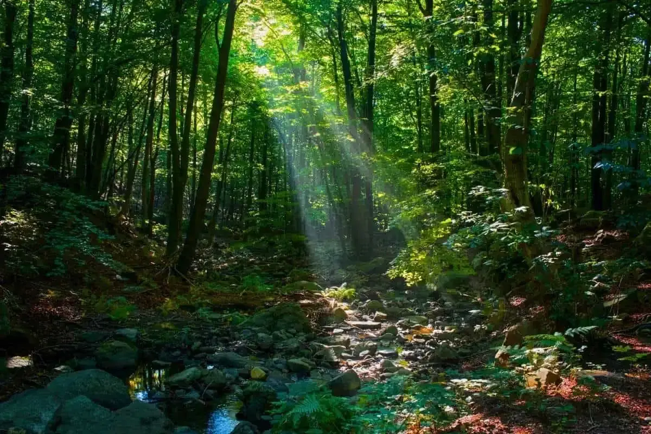
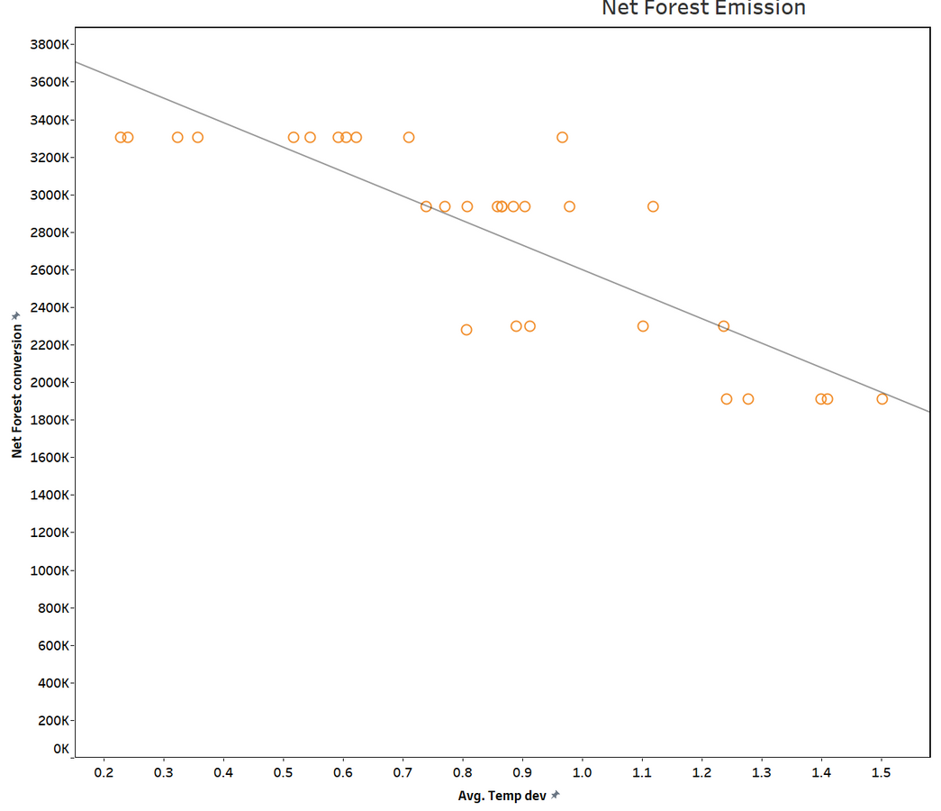
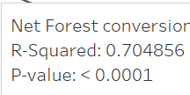
Net Forest Conversion
and
Temperature Deviation

Slide 22
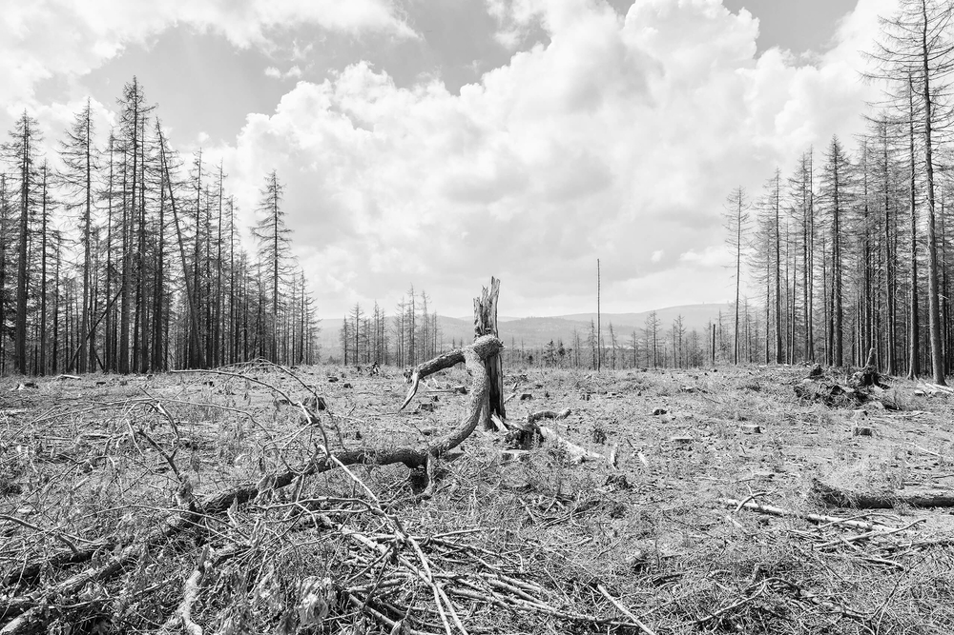
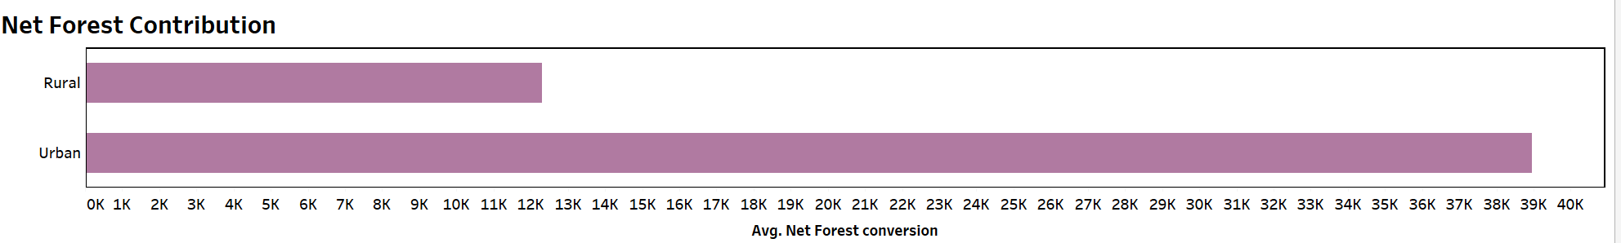
Net Forest Conversion
and
Temperature Deviation

Slide 23
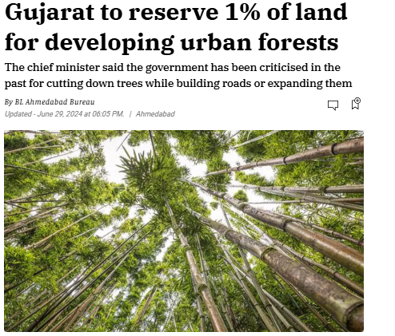
Greater Forest Awareness in Urban Regions
https://gandhinagarportal.com/indroda-park-gandhinagar/

Slide 24


Thank You!

